Slide 1

JavaScript
.NET

Slide 2
JavaScript (JS) is a programming language that conforms to the ECMAScript specification. JavaScript is high-level, often just-in-time compiled, and multi-paradigm. It has curly-bracket syntax, dynamic typing, prototype-based object-orientation, and first-class functions.
https://en.wikipedia.org/wiki/JavaScript

Slide 3
Sample .HTML doc
Create a .html and save the below inside
<!DOCTYPE html>
<script>
//your JS code here
</script>

Slide 4
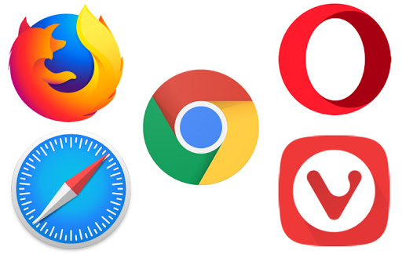

Chrome Debugging – Overview https://javascript.info/debugging-chrome
All modern browsers and most other environments support Debugging Tools.
Debugging Tools is a special UI in developer tools that makes debugging in the browser much easier. It allows to trace the code step-by-step to see what exactly is going on.
Chrome has many features and most other browsers have a similar process.
Follow this tutorial to learn how to debug in Chrome (or any other browser).

Slide 5
JavaScript – Overview https://www.w3schools.com/js/default.asp
JavaScript was invented by Brendan Eich in 1995 and became an ECMA standard in 1997. ECMA-262 is the official name of the standard. ECMAScript is the official name of JavaScript.
It’s one of the 3 languages all web developers must learn:
1. HTML defines the content of web pages.
2. CSS specifies the layout of web pages.
3. JavaScript is for programing the behavior of web pages.
JS is well-known as the scripting language for Web pages, but many desktop and server programs use JavaScript also. Node.js, jQuery, Angular, React and many others are examples of programs that use JS or are libraries of JS.

Slide 6
JavaScript – Overview https://developer.mozilla.org/en-US/docs/Web/JavaScript
JavaScript (JS) is a…
prototype-based,
multi-paradigm,
single-threaded,
dynamic,
case-sensitive,
interpreted (just-in-time compiled)
…programming language that supports
object-oriented,
imperative, and
declarative (e.g. functional programming)
styles.
Do not confuse JavaScript with the Java programming language. Both "Java" and "JavaScript" are trademarks or registered trademarks of Oracle in the U.S. and other countries.
The two programming languages have very different syntax, semantics, and uses.

Slide 7
Is there an official JS reference?
Nope. We’ll use these.
https://developer.mozilla.org/en-US/docs/Web/JavaScript/Guide
The Modern JavaScript Tutorial
https://en.wikipedia.org/wiki/JavaScript

Slide 8
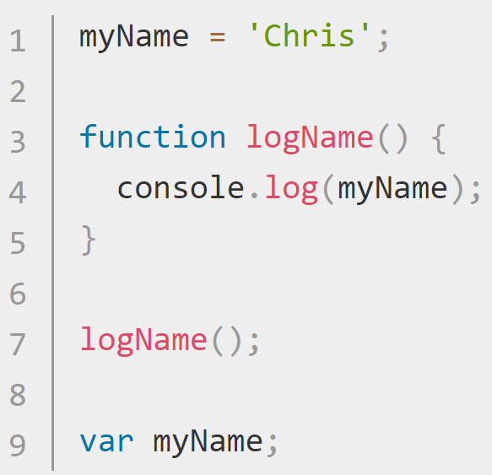
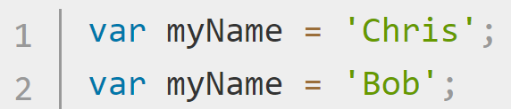
JavaScript – Declaring Variables (var and let) https://developer.mozilla.org/en-US/docs/Learn/Getting_started_with_the_web/JavaScript_basics https://developer.mozilla.org/en-US/docs/Learn/JavaScript/First_steps/Variables#The_difference_between_var_and_let
JS creates variables in two ways. ‘let ’ and ‘var’
When JavaScript was first created, there was only var, which works fine in most cases, but its design can be confusing. If you write a multiline JavaScript program that declares and initializes a variable, you can declare a variable with var after you initialize it and, because of hoisting, it will still work. You can also redeclare a variable multiple times with var.
let was created to fix issues with var.
Use let (rather than var) unless you need to support versions of IE below v11

Slide 9
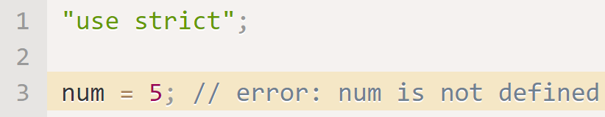
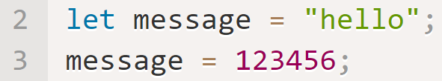
JavaScript – Basic Variable Declaration Rules https://javascript.info/variables#a-variable
Variables can be considered objects with helper methods. (more)
You don’t have to declare variable types in JavaScript.
Numbers don’t need quotes, but strings and chars do.
You an declare multiple variables in one line.
camelCase is conventionally used for variables
Variables cannot start with a number.
Variables are case-sensitive.
Conventionally , Latin chars (0-9, a-z, A-Z) are used for variables.
Don’t use JS keywords.
Place “use strict”; at the top of .js files to enforce newer conventions (like declaring a variable before defining it).
Declare an unchanging variable with const.
Use ALL CAPS for const variables known before compile-time.
Use meaningful names for variables.
JS is dynamically typed. This means a variable can be a string and then be a number and then be a float.

Slide 10
JavaScript – Primitive DataTypes https://javascript.info/types
Datatype | Example | Details
Number (int) | let num = 10; | Operations include *, /, +, -, etc. Includes NaN(not a number) and infinity
Number(floating point) | let num1 = 7087.542
BigInt | 1234567890123456789012345678901234567890n; | Represents any value > 2^53 or < -2^53 (16 digits) or ints of arbitrary length. Use ‘n’ at the end of a BigInt.
String | let str1 = “there“; let str2 = ‘tiger’; let str3 = `Hey ${str1}, ${str2}`; | Must be surrounded by quotes. You can use ‘str’, “str”, or `str` (backticks). Use `str ${otherStr}` for string interpolation. JS has no char type.
Boolean | let isBool = true; let isTrue = 2>1; | Only has 2 values.
null | let age = null; | A special value which represents “nothing”, “empty” or “value unknown”. null is not a reference to an object.
undefined | let x; //x is undefined | The meaning of undefined is “value is not assigned”.

Slide 11
JavaScript – Object Data Type and Misc. https://javascript.info/types
Datatype | Example | Details
Object | //use a constructor let john = new User(); // build an object let user = { name: "John", age: 30 }; | Objects are used to store collections of data and more complex entities in a key-value pair format.
typeof operator | Console.log(typeof x); Console.log(typeof(x)); | Returns a string of the type of the argument. It’s useful when processing different types differently.
Symbol | let id = Symbol("id"); | Object property keys may only be either of string type, or of symbol type. Symbols are guaranteed to be unique.

Slide 12
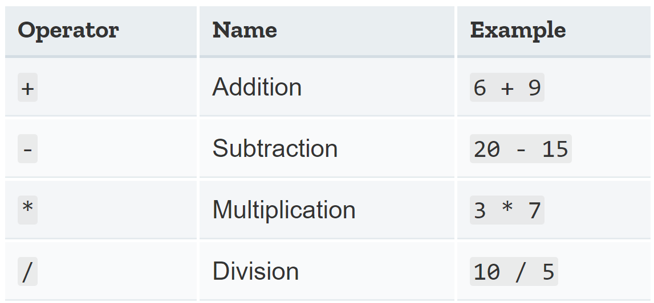
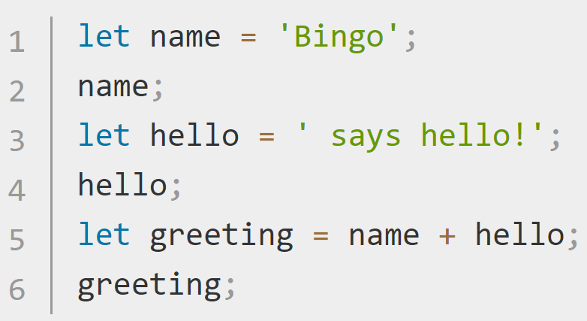
Operands and Operators https://developer.mozilla.org/en-US/docs/Learn/JavaScript/First_steps/A_first_splash https://javascript.info/operators#terms-unary-binary-operand
An operand is what operators are applied to.
For instance, in 5 * 2 there are two operands: the left operand is 5 and the right operand is 2.
JavaScript operators allow us to perform tests, do math, join strings together, and other such things. A unary operator has a single operand (let x = 4;), while a binary operator has two operands (let x = y + z;).
You can also use the + operator to join text strings together (in programming, this is called concatenation). Try entering the following lines, one at a time in the browser console.
If one operand it a string, the other is converted to a string, too. Try let new = “hello” + 4;

Slide 13
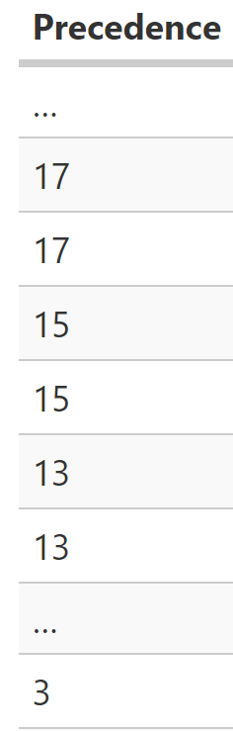
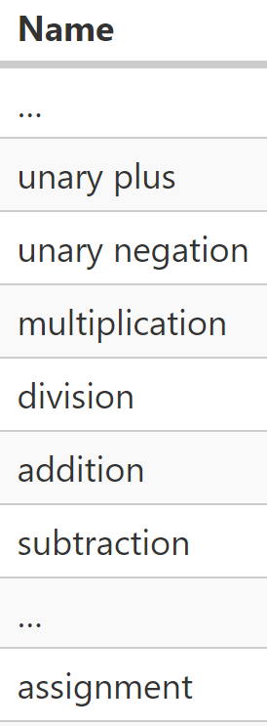
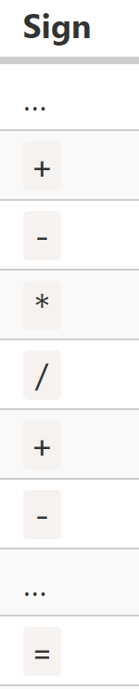
Operator precedence https://javascript.info/operators#operator-precedence https://developer.mozilla.org/en/JavaScript/Reference/operators/operator_precedence
Execution order is defined by operator precedence. Parentheses override any precedence. (1 + 2) * 2 = 6.
There are many operators in JavaScript. Every operator has a corresponding precedence number. The one with the larger number executes first. If the precedence is the same, the execution order is from left to right.
You can chain assignments. In a = b = c = 2 + 2; a, b, and c == 4.

Slide 14
More Operators https://javascript.info/operators
Operator | Example | Description
% | 6%4 == 2 | ‘%’ is modulus and gives the remainder.
++ | a = 5, a++ == 6 | ‘++’ increments by 1. ‘- -’ decrements by 1. Placed before the variable, ‘++’ or ‘- -’ occurs before the action. Placed after the variable, ‘++’ or ‘- -’ happens after the action.
- - | a = 5, a- - == 4
** | a == 4, b == 3; a**b == 48. | ‘**’ is the exponent operator. a is multiplied by itself b times.
+= | let n = 2; n += 5 == 7 | Modify-in-place. Shorthand notation to add, subtract, multiply or divide then save the result to the left-hand variable;
-= | let n = 2; n -= 5 == -3
*= | let n = 2; n *= 5 == 10
/= | let n = 10; n /= 5 == 2

Slide 15
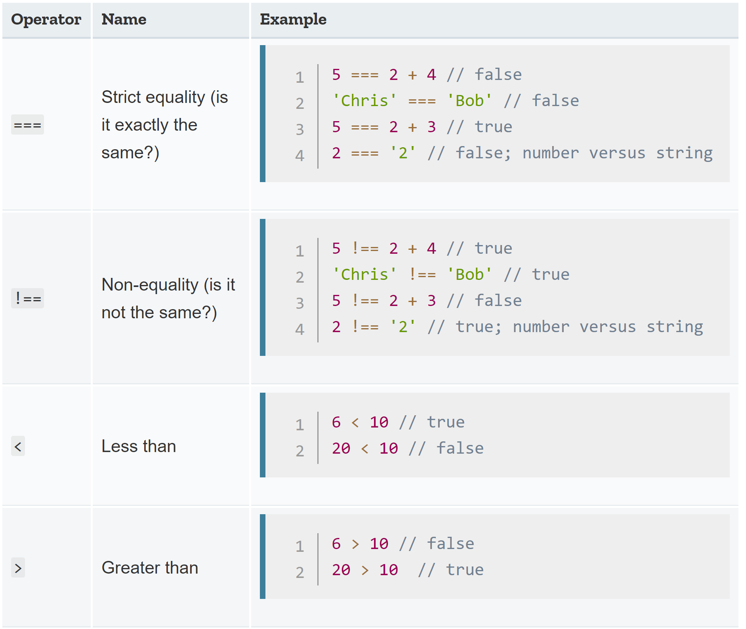
JS – =, ==, and === Operators https://javascript.info/object#copying-by-reference
= | == | ===
Assignment | Equality | Strict equality
Let a = { }; Let c = { }; let b = a; Let d = “134”; Let e = 134 | a == b == true | a === b == true
 | a == c == false | a === c == false
 | d == e == true | d === e == false

Slide 16
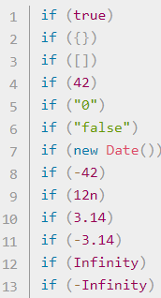
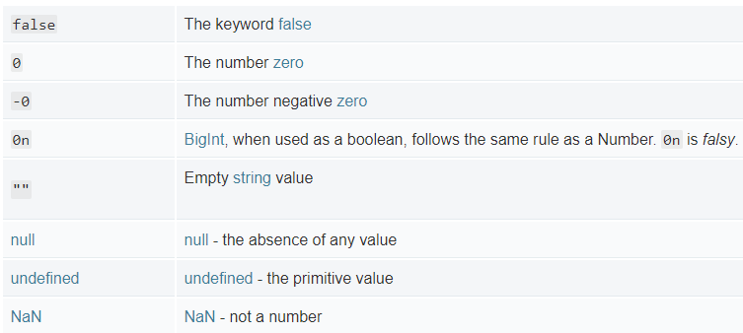
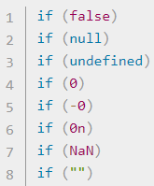
Truthy/Falsy https://javascript.info/logical-operators https://developer.mozilla.org/en-US/docs/Glossary/Truthy https://developer.mozilla.org/en-US/docs/Glossary/Falsy
In JavaScript, a truthy value is a value that is considered true when viewed in a Boolean context. All values are truthy unless they are defined as falsy.
A falsy value is a value that is considered false when viewed in a Boolean context.

Slide 17
JavaScript – Math Helper Functions https://developer.mozilla.org/en-US/docs/Web/JavaScript/Reference/Global_Objects/Math
JavaScript has a built-in Math object which contains a small library of mathematical functions and constants.
Function | Description | Example
Math.random(); | returns a floating-point, pseudo-random number in the range 0 to less than 1 | Math.random()*10; //3.229976827519583
Math.abs(x); | returns the absolute value of a number | Math.abs(-10 – 6.3); //16.3
Math.pow(x,y); | returns x to the power of y | Math.pow(7, 3); //343
Math.floor(x); | returns the largest integer less than or equal to a given number | Math.floor(5.05) //5
Math.ceiling(x); | rounds a number up to the next largest whole number or integer. | Math.ceil(11.324); //12
Math.max(a,b,…z) | returns the largest of zero or more numbers | Math.max(1, 3, 2); //3

Slide 18
Map and Weak Map https://javascript.info/map-set#map https://javascript.info/weakmap-weakset#weakmap
Map | WeakMap
Map is a collection of key-value data items, just like an Object. | WeakMap keys must be objects, not primitive values:
Any type of key is possible. Even Object! | Weak Map does not prevent garbage-collection of key objects
Insertion order is used for iteration order. | If you remove all other references to an object key, the object is removed from memory (and the Map()!).
 | WeakMap does not support iteration or methods keys(), values(), entries()
 | There is no way to get all keys or values from a map
 | When working with an object and storing data associated with it (that should only exist while the object is alive) WeakMap is exactly what’s needed.

Slide 19
Set and Weak Set https://javascript.info/weakmap-weakset#weakset https://javascript.info/map-set#set
Set | Weak Set
A Set is a special type collection – “set of values” (without keys), where each value may occur only once. | Just like Set but only Objects are allowed.
The alternative to a Set is an array of users and code to check for duplicate users. | An object exists in the set while it is reachable from somewhere else.
 | Being “weak”, it serves as an additional storage. But only for “yes/no” facts. (use .has(obj) helper function).
 | WeakSet is not iterable and does not support .size(), or .keys()

Slide 20
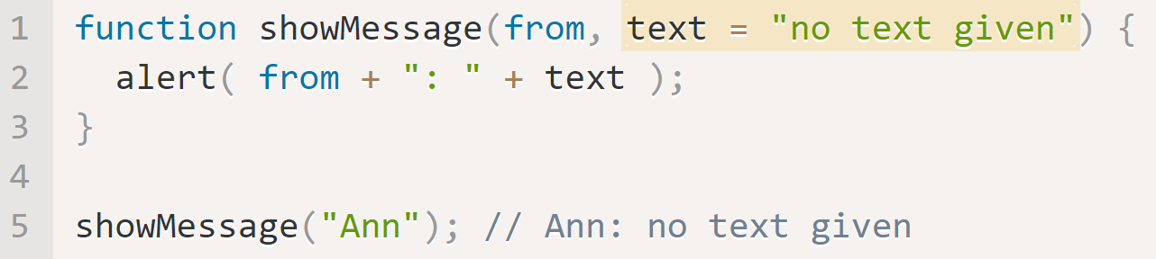
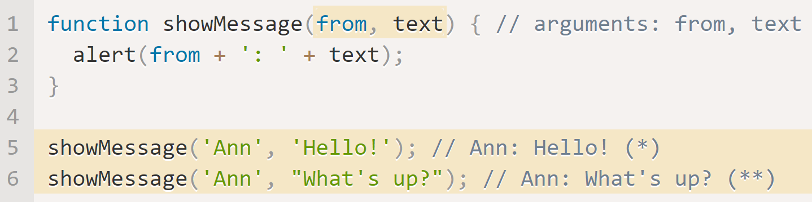
JavaScript – Function Declarations https://javascript.info/function-basics
The function keyword goes first, then goes the name of the function, then a list of parameters between the parentheses (comma-separated) then “the function body”, between { }.
Functions can declare local variables and access variables within the same scope. A local variable declared with the same name shadows an outer variable. Variables are passed by reference in JS.
A function with multiple parameters can be called with fewer arguments. The unused parameters are shown as undefined.
A parameter can be given a default value.

Slide 21
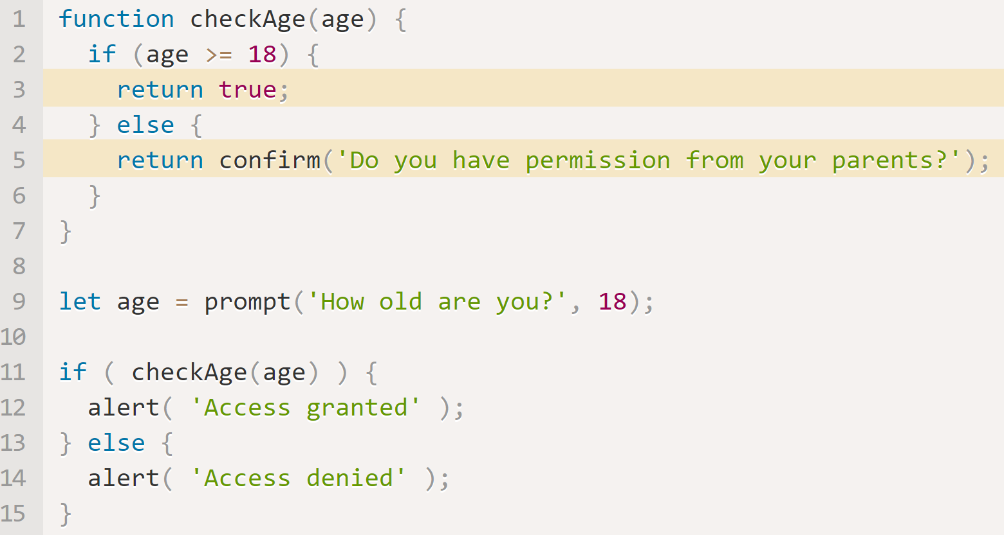
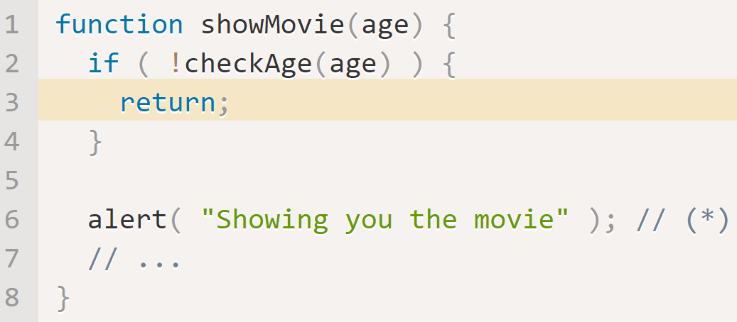
JavaScript – Functions https://javascript.info/function-basics
A function can return a value at any point using return;. It can also return; without a value. Never place return data on a separate line. JS assumes a ; after return.
In JavaScript, a function is a value, so we can deal with it as a value. This code shows its string representation. We can call it like sayHi(), but it’s still a value so we can work with it similar to other kinds of values. We can also copy a function to another variable.

Slide 22
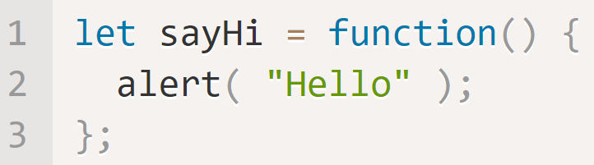
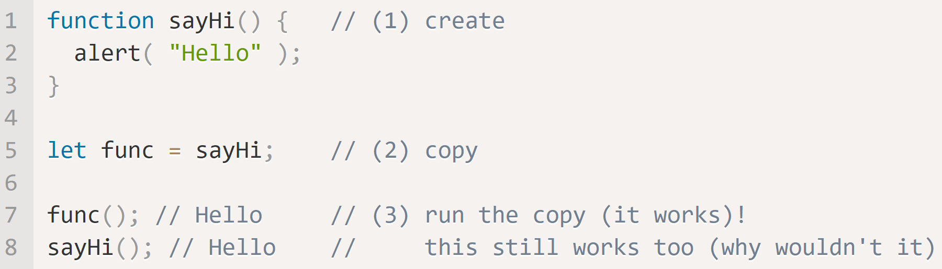
JavaScript – Function Expressions https://javascript.info/function-expressions
In JavaScript, a function is a value, so we can deal with it as a value. This code shows a function expression.
We can call it like sayHi(), but it’s still a value so we can pass it similar to other kinds of values. A Function Expression is created when the execution reaches it and is usable only from that moment.
Here, the Function Declaration:
(1) creates the function and puts it into a variable: sayHi.
(2) copies it into the variable func.
Now the function can be called as both sayHi() and func().
*If there were parentheses after sayHi, func = sayHi() would write the result of the call sayHi() into func, not the function sayHi itself.

Slide 23
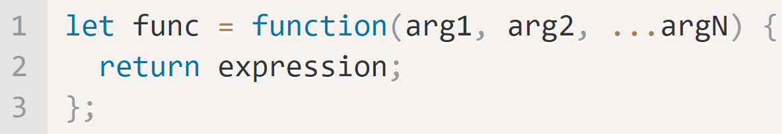
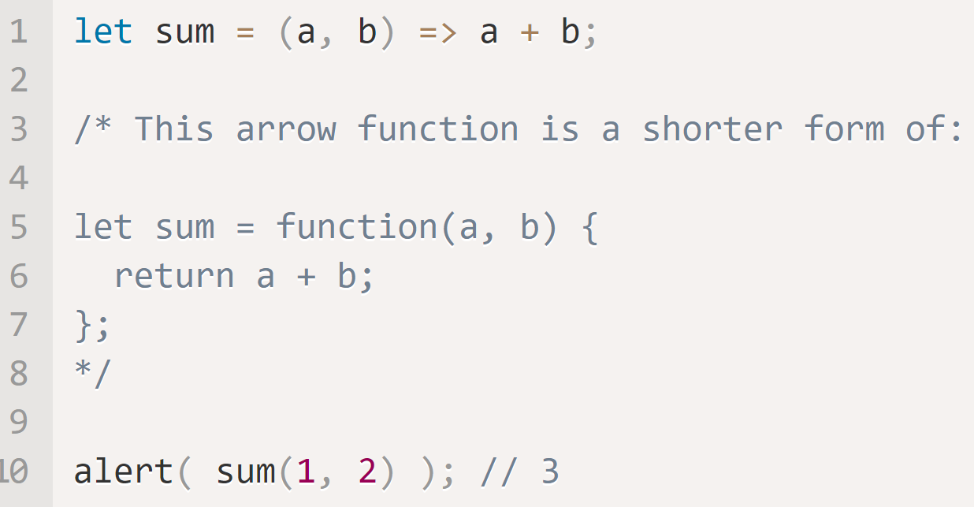
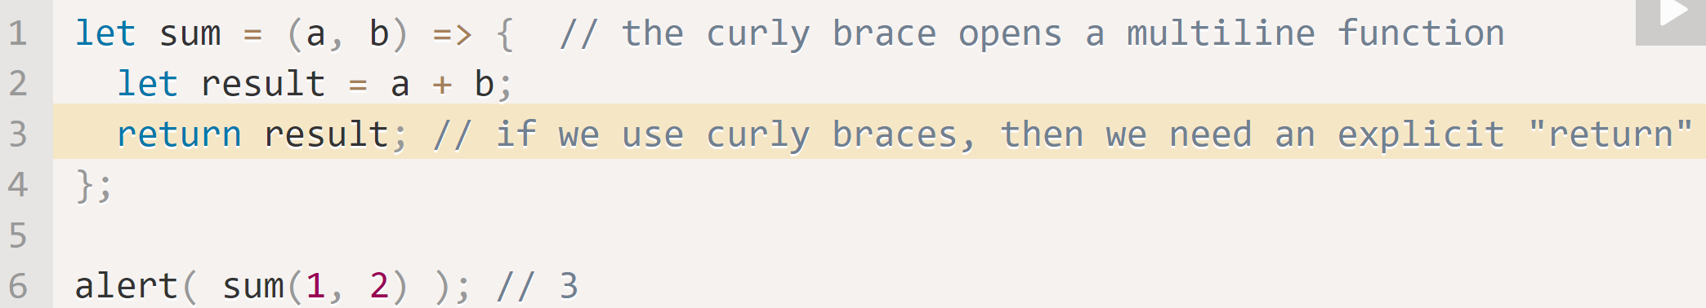
Arrow Functions https://javascript.info/arrow-functions-basics
Arrow Functions are (yet another) a very simple and concise syntax for creating functions. Both the below expressions create a function that accepts arguments arg1..argN, then evaluates the expression and returns its result into func.
Is the same as…
This function accepts two arguments: a, b. It returns the result of a + b.
With one argument, ( ) are not required. With zero arguments empty ( ) are required.

Slide 24
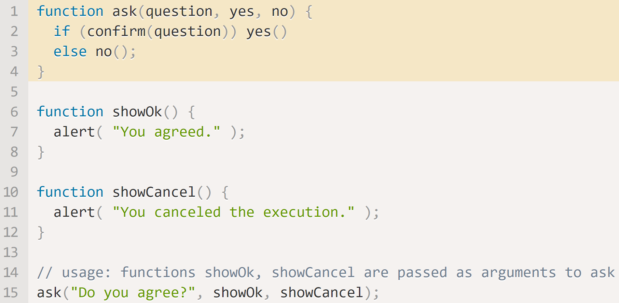
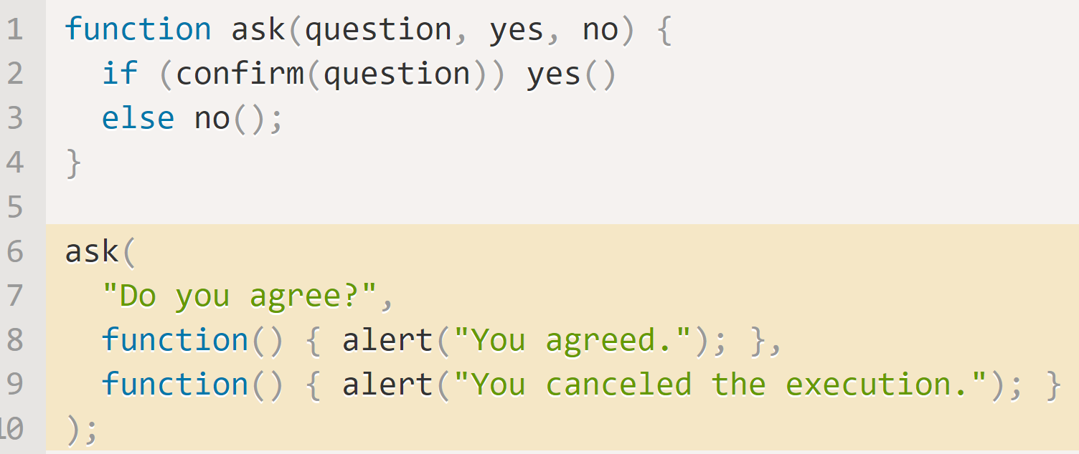
JavaScript – Callback Functions https://javascript.info/function-expressions#callback-functions
Pass functions as values. (Line 15)The arguments showOk() and showCancel() of the call to ask() are called callback functions.
A function can be passed to be “called back” later (if necessary). showOk() becomes the callback for a “yes” answer, and showCancel() for a “no” answer.
We can use Function Expressions to write the same function, but much shorter. These are called Anonymous Functions and are very common

Slide 25
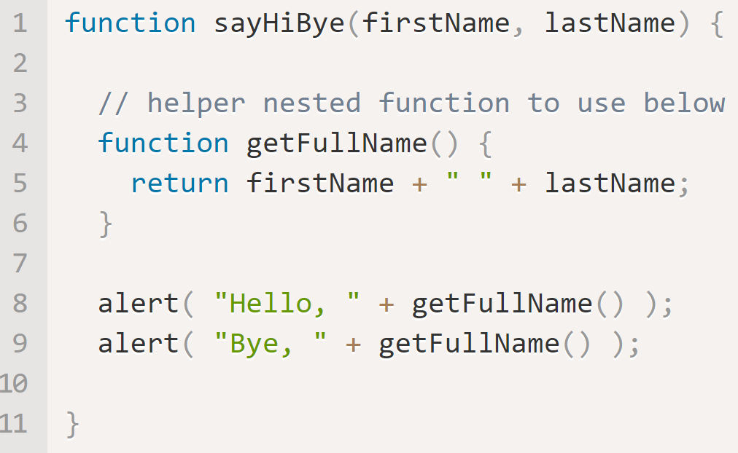
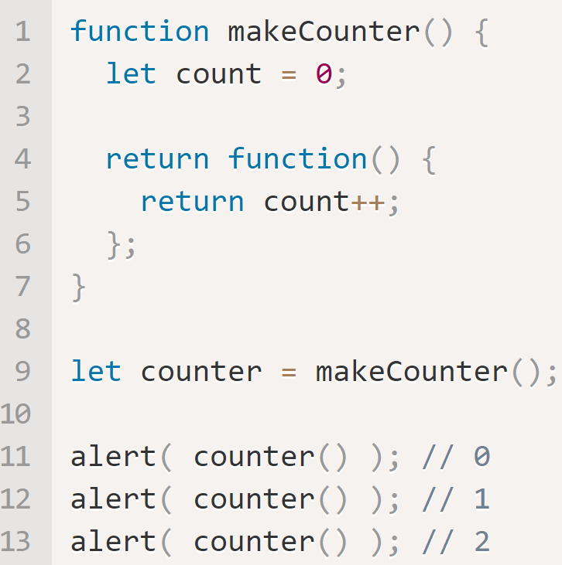
Scope with Nested Functions https://javascript.info/closure
var is function scoped and let is block scoped. It can be said that a variable declared with var is defined throughout the program as compared to let.
If a variable is declared inside a code block {...}, it’s only visible inside that block.
A nested function can access variables declared inside it’s code block and inside it’s parent code block.
A nested function can be returned (as a property of a new object or as a result by itself). It can then be used anywhere else and it will still have access to the same outer variables.

Slide 26
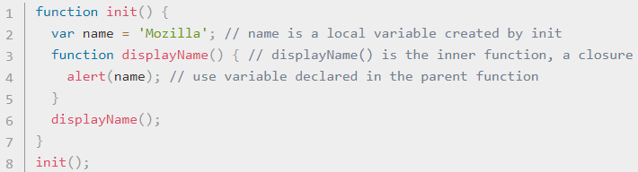
Scope and Closure https://developer.mozilla.org/en-US/docs/Web/JavaScript/Closures
A closure is the combination of a function enclosed with references to its surrounding state (the lexical environment). A closure gives you access to an outer function’s scope from an inner function.
init() creates local variable (name) and a function (displayName()). displayName() is an inner function defined inside init(). It’s available only within the body of init(). displayName() has no local variables. Because inner functions have access to outer function variables, displayName() accesses name declared in the parent function, init(). This is Lexical Scoping.

Slide 27
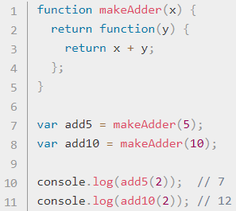
Scope and Closure https://developer.mozilla.org/en-US/docs/Web/JavaScript/Closures
makeAdder(x) takes a single argument, x, and returns a new function. The returned function takes a single argument y, and returns x + y.
add5 and add10 are both closures. They share the same function body definition, but store different lexical environments. add5's lexical environment, x is 5, while in add10,
x is 10.

Slide 28
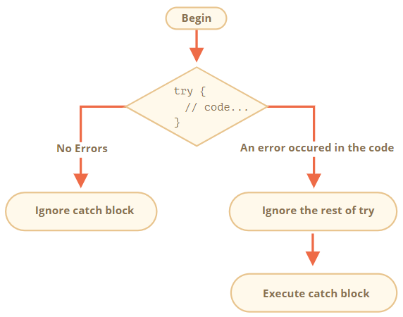
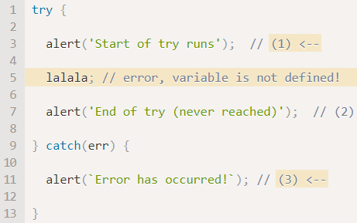
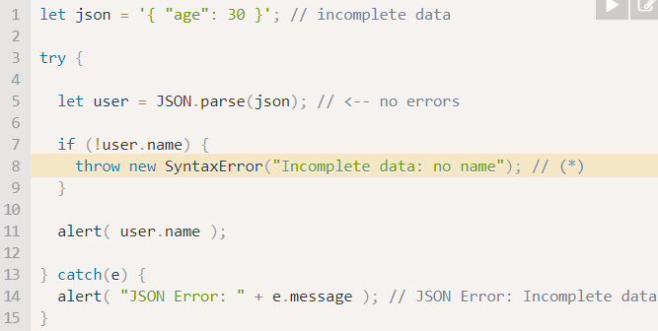
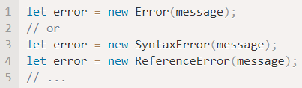
Try/Catch/Finally https://javascript.info/try-catch#the-try-catch-syntax
The JS Try/Catch block works similarly to the C# Try/Catch Block. There is only one error object generated. The error object has three parts
Name – the Error Name, Like “Reference Error”.
Message – a textual message about error details
Stack – a string with information about the sequence of nested calls that led to the error.
You can create your own error
JavaScript has many built-in constructors for standard errors: Error, SyntaxError, ReferenceError, TypeError and others.
The Finally Block always executes.

Slide 29
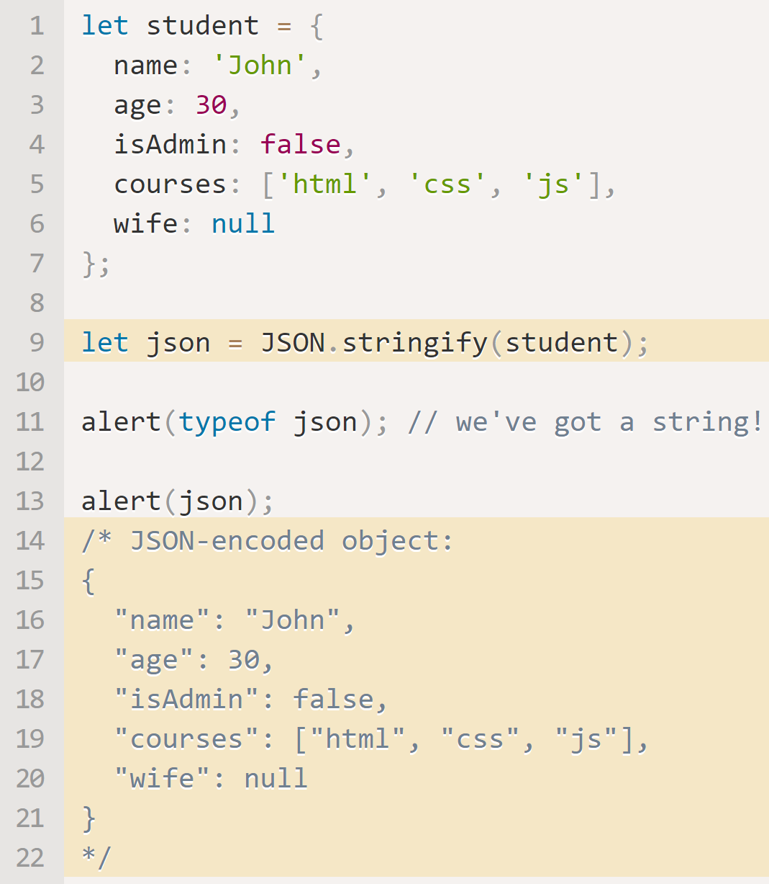
JSON and JSON Methods https://javascript.info/json
JSON (JavaScript Object Notation) is a general format to represent values and objects. Initially it was made for JavaScript, but many other languages have libraries to handle it as well. JSON is used for data exchange. JavaScript provides two methods:
JSON.stringify to convert objects into JSON.
JSON.parse to convert JSON back into an object.
The method JSON.stringify(student) takes the object and converts it into a string.
The json string is called a JSON-encoded or serialized or stringified object. It is ready to be sent over the wire or put into a plain data store. Pay close attention to the format.

Slide 30
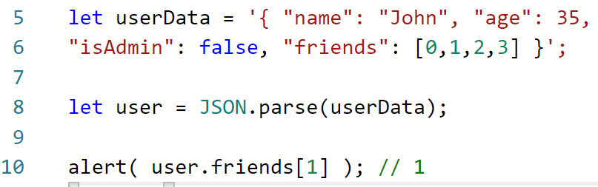
JSON.parse https://javascript.info/json#json-parse
JSON.parse decodes a JSON string.
The JSON may be as complex as necessary, objects and arrays can include other objects and arrays. But they must obey the same JSON format.

Slide 31
JavaScript – Type Conversion
Most of the time, operators and functions automatically convert the values given to them to the right type. The three most widely used type conversions are to string, to number, and to boolean.
String() | Number() |  | Boolean()
 | If input is… | Result is…. | If input is… | Result is….
String(value) | undefined | NaN | 0 null undefined nan “” | false
Any value can be converted to a string. | null | 0
 | true / false | 1 / 0
 | string | Whitespaces are ignored. An empty string becomes 0. An error gives NaN.
 |  |  | anything else | true

Slide 32
Interaction: alert, prompt, confirm https://javascript.info/alert-prompt-confirm
The browser functions alert(), prompt() and confirm() allow interaction with and input from the user.
Alert(message) | Prompt(title, [default]) | Confirm()
This shows a message and pauses script execution until the user presses “OK”. | Shows a modal window with a text message, an input field for the visitor, and the buttons OK/Cancel. Default is the initial value for the input field. | The function confirm shows a modal window with a question and two buttons: OK and Cancel.

Slide 33
Event Listeners and Event Handlers https://developer.mozilla.org/en-US/docs/Learn/JavaScript/First_steps/A_first_splash
The constructs that listen out for the event happening are called event listeners, and the blocks of code that run when the event fires are called event handlers. For example:
guessSubmit.addEventListener('click', checkGuess);
consists of a variable (guessSubmit) holding all the data from an element. It is using a built-in helper function called addEventListener() which takes two arguments (aka, has two parameters).
The type of event we are listening out for (in this case click) as a string, and
the code we want to run when the event occurs (in this case the checkGuess() function).
Note that we don't need to specify the parentheses when writing it inside addEventListener().

Slide 34
Bubbling and Capture https://developer.mozilla.org/en-US/docs/Web/API/Document_Object_Model/Examples#Example_5:_Event_Propagation https://developer.mozilla.org/en-US/docs/Learn/JavaScript/Building_blocks/Events
Event bubbling and capture are two mechanisms that describe what happens when two handlers of the same event type are activated on one element.
When an event is fired (a ‘click’) on an element that has parent elements, modern browsers run two different phases — the capturing phase and the bubbling phase.
Capture Phase | Bubble Phase
The browser checks to see if the element's outer-most ancestor (<html>) has an ‘onclick’ event handler registered on it and runs it if so. Then it moves on to the next element inside <html> and does the same thing, until it reaches the element that was actually clicked. | The browser checks to see if the element that was actually clicked on has an onclick event handler registered on it for the bubbling phase and runs it if so. Then it moves on to the next immediate ancestor element and does the same thing until it reaches the <html> element.

Slide 35
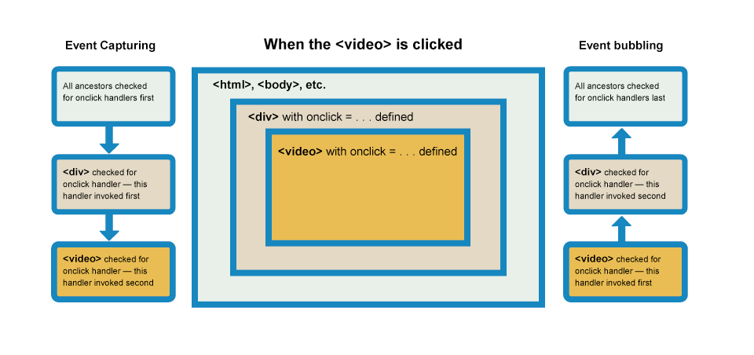
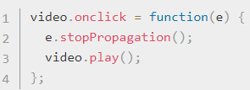
Bubbling and Capture https://developer.mozilla.org/en-US/docs/Web/API/Document_Object_Model/Examples#Example_5:_Event_Propagation https://developer.mozilla.org/en-US/docs/Learn/JavaScript/Building_blocks/Events
Browsers automatically register event handlers for the bubbling phase.
When you click a video, the click event bubbles from the <video> element outwards to its parent <div> element, then to the <html> element. Along the way, if any of these elements has an ‘on-click’ event handler, they will fire, too.
.stopPropagation() is provided to stop further propagation.

Slide 36
Things that are the same as in C#
Conditional operators
Logical Operators
Loops and Switch statements
NOT a complete list..

